Slide 1
以區塊鍊及深度神經網路設計霧運算物聯網之分散式安全 Securing Fog-based IoT Systems using Blockchain and Deep Neural Networks
國立中正大學 資訊工程學系
嵌入式系統實驗室
107年度計畫

Slide 2
Contents
Fog Computing Introduction
What? Why? How?
Project Introduction
Open Research Questions
Proposal
Yearly Deliverables
Yearly Tasks
Project Teams

Slide 3
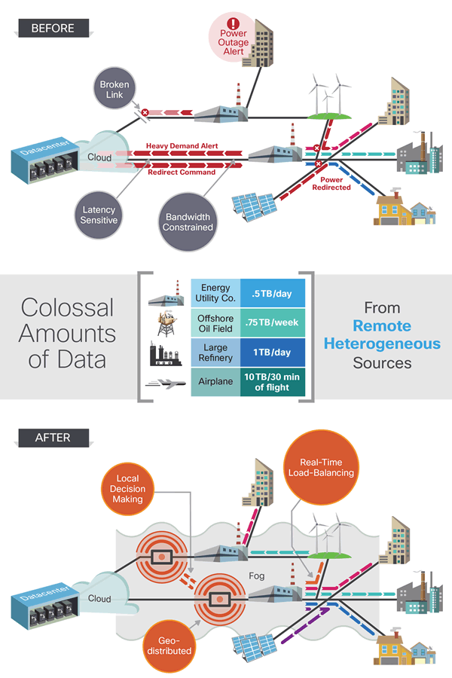
Fog Computing Introduction
What is Edge/Fog Computing?
Fog computing is a term created by Cisco in January 2014 that refers to extending cloud computing to the edge of an enterprise's network.
Also known as Edge Computing or fogging, fog computing facilitates the operation of compute, storage and networking services between end devices and cloud computing data centers.

Slide 4
Fog Computing Introduction
Why Fog Computing?
Minimize latency
Conserve network bandwidth
Address security/privacy concerns
Operate reliably
Save power/energy

Slide 5
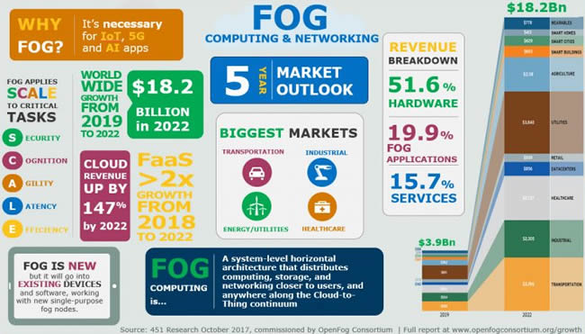
Future of Fog Computing

Slide 6
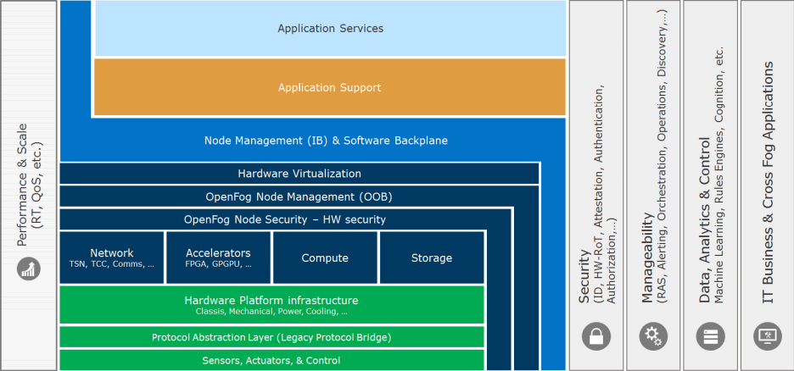
Fog Computing Introduction
OpenFog Consortium

Slide 7
Project Introduction
APT: Advance Persistence Threats, ACI: Access Control Issues, HI: Account Hijacking, DoS: Denial of Service, DB: Data Breaches, DL: Data Loss, IA: Insecure APIs, SAV: System & App Vulnerability, MI: Malicious Insider, IDD: Insufficient Due Diligence, ANU: Abuse & Nefarious Use, STI: Shared Technology Issues

Slide 8
Project Target Issues
Data Integrity
Causes: Data Breaches, Data Loss, Insecure APIs, System & Application Vulnerability, Malicious Insider, Abuse and Nefarious Use, Shared Technology Issues,
Anomaly
Causes: all 12 possible

Slide 9
Project Goals
Two Important Security issues of Fog-based IoT
Data Integrity
Anomaly
Solution
Blockchain for data integrity
Deep neural networks for anomaly detection
Malware
Weak Data Integrity
DNN-based Anomaly Detection for IoT
Smart Blockchain for IoT
Blockchain Security Customized for IoT
Proposed Solutions for Fog-based IoT

Slide 10
Open Research Questions
Is blockchain really needed for IoT?
Distributed security in IoT
How to make Blockchains Feasible for Fog-based IoT?
Network Plane: How to design BC using limited IoT bandwidth? P2P? 3-tier (local, shared, overlay)?
Consensus Plane: Which consensus algorithm to use in Fog-based IoT? Proof of stake (PoS)? BFT?
Storage Plane: How to store ledger in IoT? Sharding?
View Plane: How much of ledger need to be stored as a view by edge devices in Fog-based IoT?
How to use DNN for anomaly detection in IoT?
Light-weight? Accurate? How to leverage Spatio-temporal features of IoT data?

Slide 11
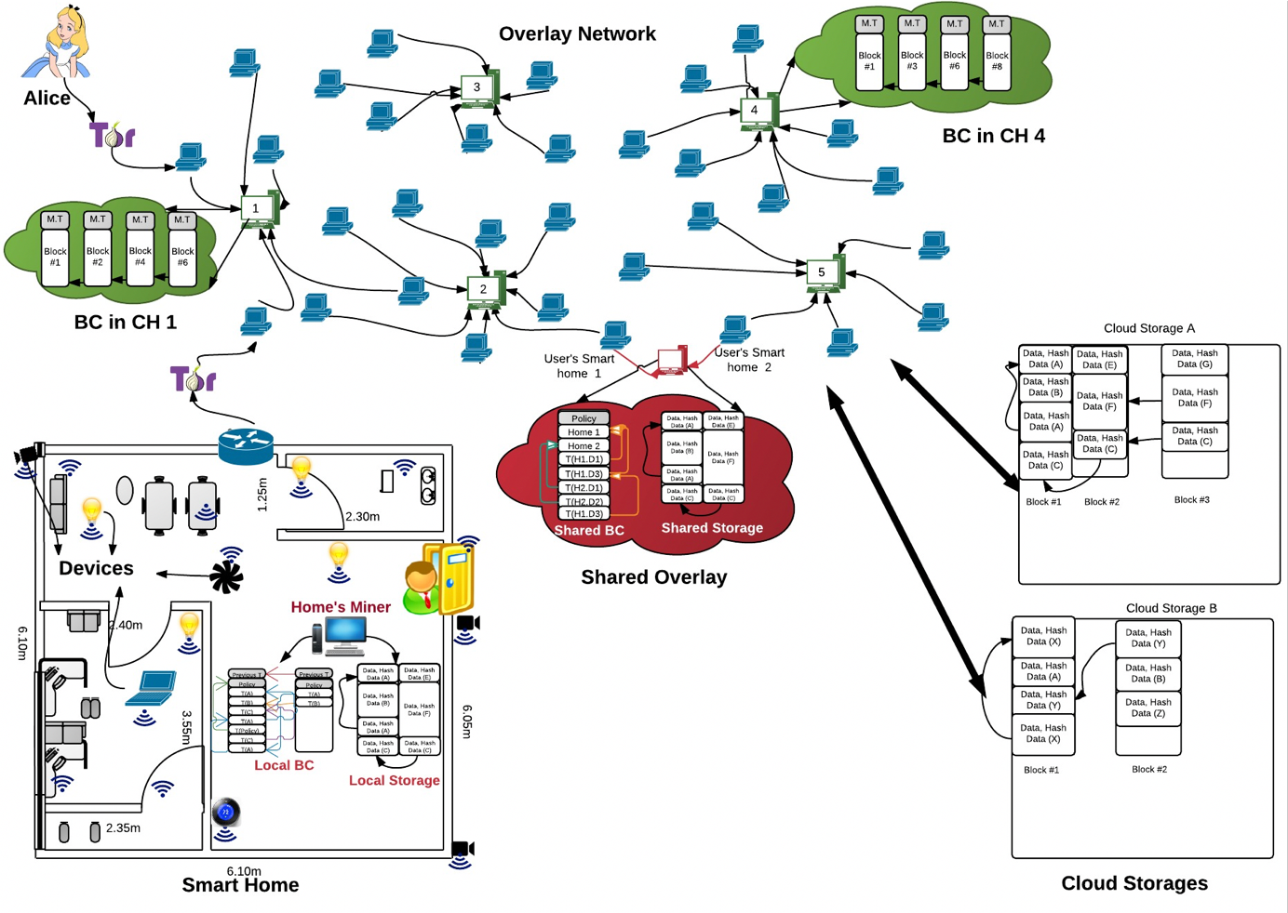
Block-based IoT Architecture
A. Dorri, S.S. Kanhere, and R. Jurdak, “Blockchain in Internet of Things: Challenges and Solutions,” CoRR, arXiv:1608.05187v1, http://arxiv.org/abs/1608.05187, August 2016.

Slide 12
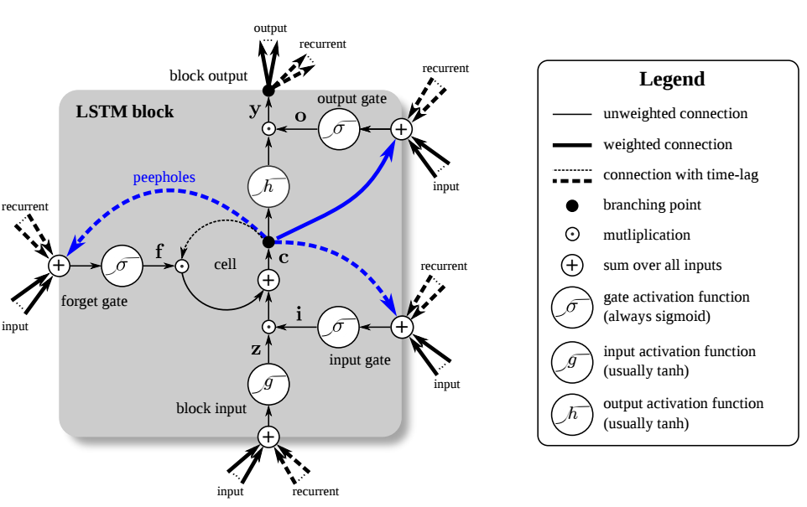
Deep Neural Networks for Anomaly Detection
LSTM RNN

Slide 13
Application: Smart Grid Security

Slide 14
Proposal: Smart Secure Fog-Based IoT
Cloud
Cloud Eco-System for Smart Secure Fog-based IoT
LSTM RNN Model Training with Application IoT Data
Edge
Heterogeneous Data Fusion
Blockchain Node Design and Transaction Initiation
Device
Sensor Device Simulation
Anomalous Data and Sensor Fault Injection
Blockchain Security Server Platform
LSTM RNN Model Inference for Anomaly Detection

Slide 15
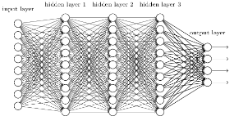

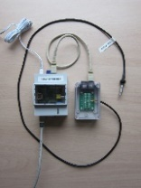
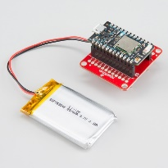
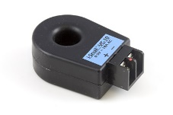
BC Design of Fog-based IoT
Kubernetes Pod with Smart Grid Agents
IEC 61499 Node
IEC 61499 Node
(encapsulating LSTM RNN model)
Kubernetes Node
(Deployed to a Cloud Server)
Create Transaction FB
Heterogeneous Data Fusion FB
Docker Containers
current clamp weather sensors battery sensors
FB: Function Block

Slide 16




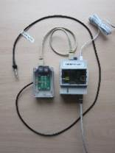

Smart Grid with Smart BC Application
Install Load A
Gen PV Power
Use Load A
Buy elect from MG
Isolate MG K
Gen TB Power
Sell elect to MG
…
④
③
Cloud-Level
HyperLedger Fabric
IEC 61499 with data fusion
②
①
②
③
Kubernetes
LSTM RNN Model
Edge-Level
Use Load
Trading Node
Fusion Node
MG Mgt Node
①
Low-Power Wide-Area Network
Device-Level
Current clamp weather sensors battery sensors

Slide 17
Yearly Deliverables
 | 1st Year | 2nd Year | 3rd Year
Cloud Eco-System | Implement ARM Mbed cloud services (SDK) for Fog-based IoT design | Customize to SGSB target application | Optimize into business-ready product of IoT cloud eco-system design
Deep Learning | LSTM RNN model construction / training and integration with Mbed | Develop programming environment of LSTM RNN | Optimize LSTM RNN Training and Programming Environments
Blockchain Platform | HyperLedger Fabric Implement in Cloud Agent layer implement at edge level using Kubernetes/Docker | Customize to SGSB target application (refer to Fig. 7) including customized transactions and smart contracts | Optimize platform for production of business-ready IoT blockchain design
Smart Grid Smart BC | Fault simulator design for smart grids | Integrate with Blockchain platform, LSTM RNN model, and eco-system. | Production-ready optimization for Smart Grid with Smart Blockchain

Slide 18
Relationship Among Project Tasks
LSTM RNN Model Training Environment
Blockchain Cloud Layer
(HyperLedger Fabric)
Cloud Platform with Blockchain Platform Design & Eco-system Design
LSTM RNN Model DNP Environment
Blockchain Agent Layer
(Kubernetes/Docker/IEC 61499)
Sensor Fault Model
Sensor Simulator Design
Anomaly Model

Slide 19
1st Year Tasks
Implement ARM Mbed Cloud Services
Construct/Train LSTM RNN Model
Integrate RNN with ARM Mbed
Design BlockChain Platform using HyperLedger Fabric
Implement Agent Layer using Kubernetes/Docker
Design Fault Simulator for Smart Grids

Slide 20
2nd Year Tasks
Customize ARM SDK to Smart Grid application
Develop DNP programming environment of LSTM RNN
Customize Blockchain to Smart Grid application, including transactions and smart contracts
Integrate with blockchain, LSTM RNN, and eco-system for Smart Grid application
Use fault simulator to test the RNN model for anomaly detection

Slide 21
3rd Year Tasks
Optimize IoT cloud eco-system for product design
Optimize LSTM RNN model
Optimize platform for blockchain product design
Test all optimizations

Slide 22
今年分組與人力分配 Project Teams and Human Resources
IoT Group (1 PhD, 3 Masters)
IoT Eco-System Development using ARM Mbed OS on some boards such as Raspberry PI, MultiTech Dot, etc. (https://os.mbed.com/platforms/)
DNN Group (1 PhD, 2 Masters)
LSTM RNN, ConvLSTM, etc. models for anomaly detection on Fog-based IoT (implement for above system)
BC Group (1 PhD, 3 Masters)
Implement a BC platform using HyperLedger Fabric, etc. for Fog-based IoT (implement for above system)

Slide 23
2018/8~2019/7 Schedule
August 10: Tell me your preferences
1st, 2nd, 3rd (BC, IoT, DNN)
Mid-August: Start Project
Mid-September: Present your project plan
Group Leader will be the PhD student
End of 2018: 1/3 of first year tasks should be finished
End of April 2019: 2/3 of first year tasks should be finished
End of July 2019: First year tasks should be finished

Slide 24
References
Cisco: https://www.i-scoop.eu/internet-of-things-guide/fog-computing-cloud-internet-things/
OpenFog: https://www.openfogconsortium.org/ra/technical-document-download/
S. Khan, S. Parkinson, and Y. Qin, “Fog computing security: a review of current applications and security solutions,” Journal of Cloud Computing: Advances, Systems and Applications, Vol. 6, No. 1, August 2017.
Read MOST Project Proposal (科技部計劃書)

